Slide 1
The Globalization Origins of Autocratic Rise
Engaged Reformers, Autocratic Advantages, and the Post-Cold War Reversal
George Yean
G3, Department of Government
Harvard University
March 3, 2025

Slide 2
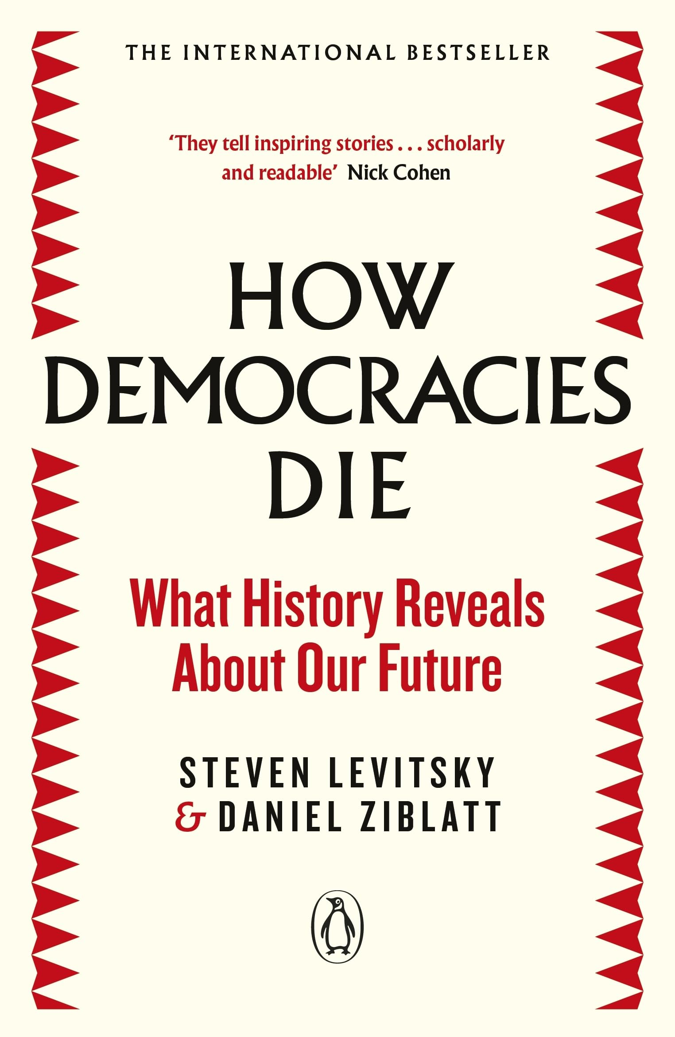
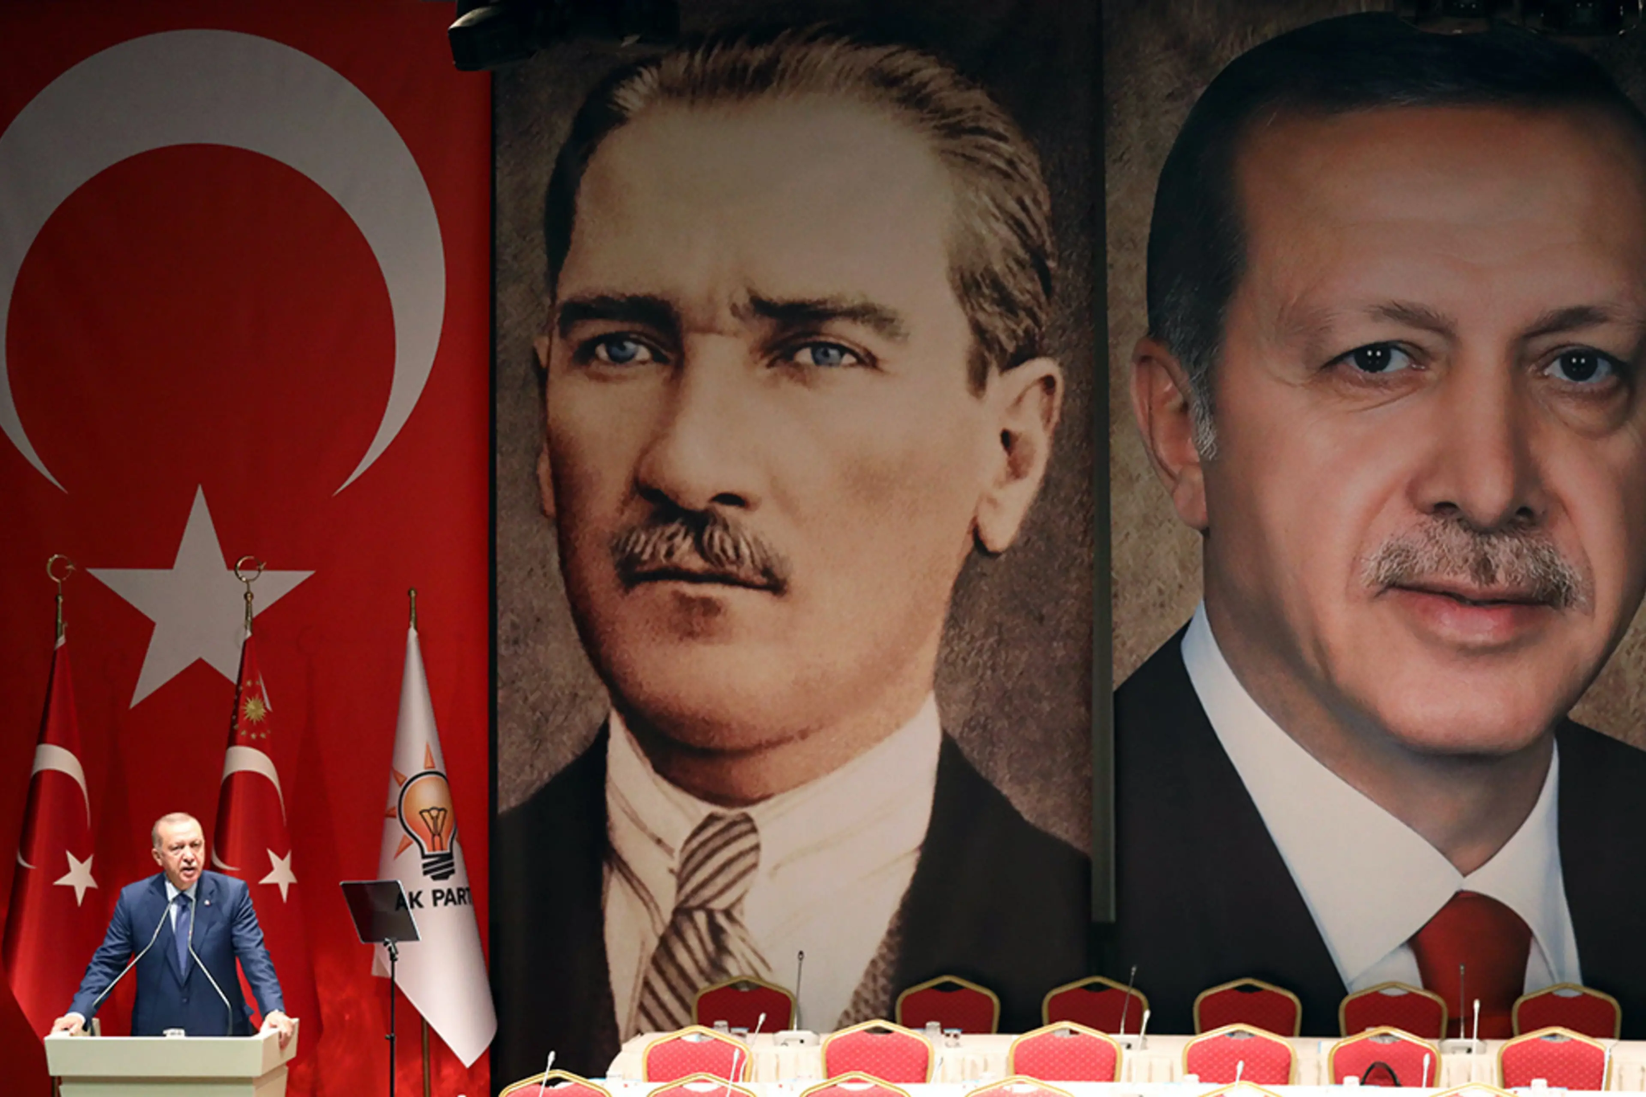
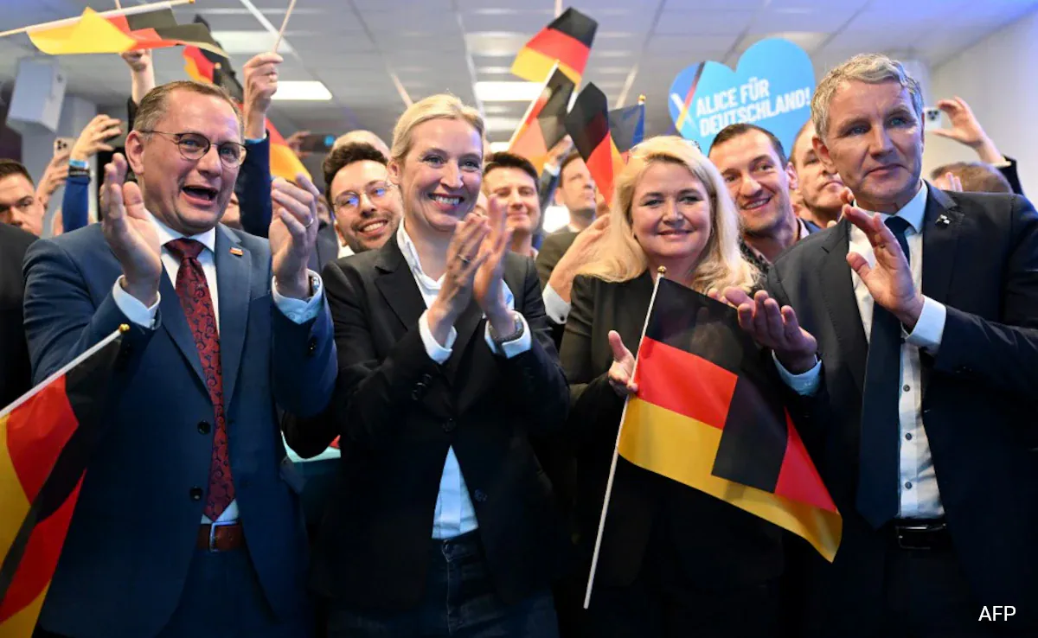
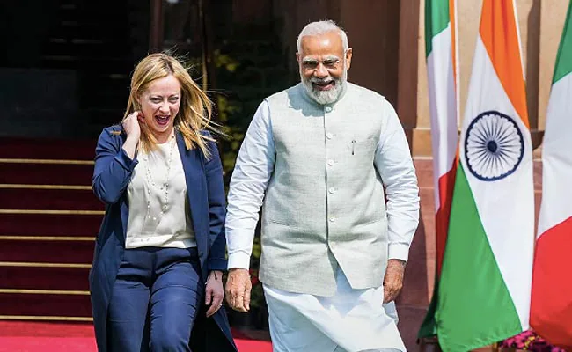
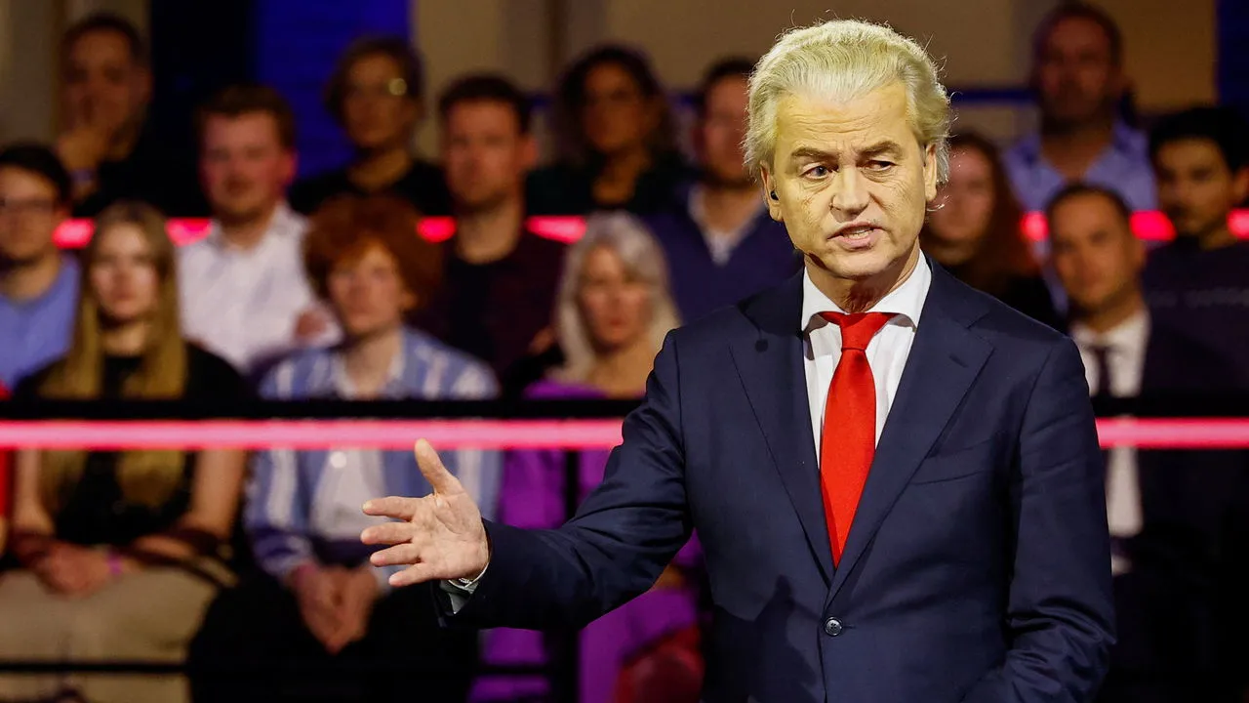
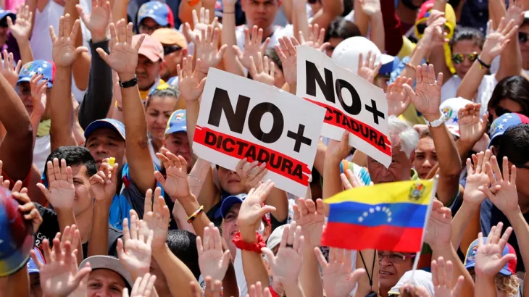

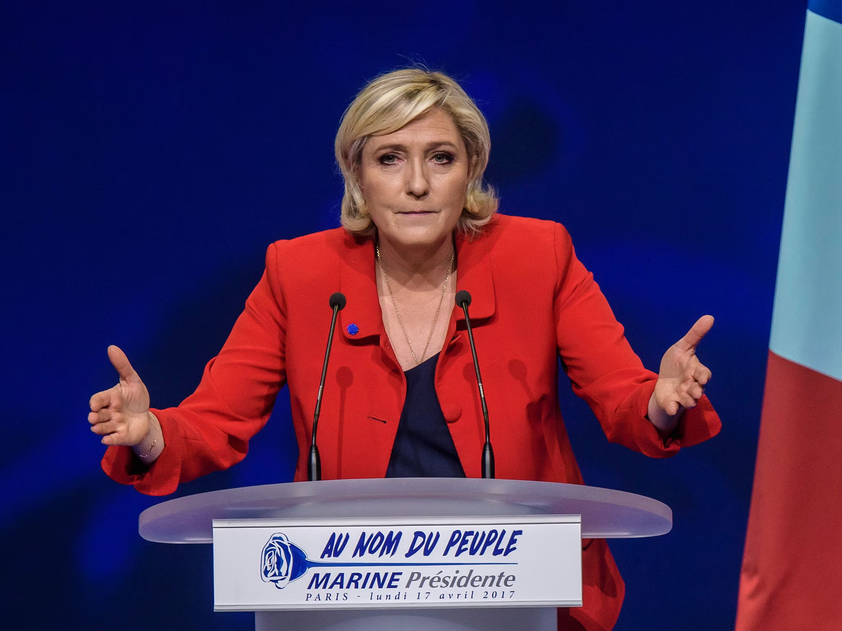
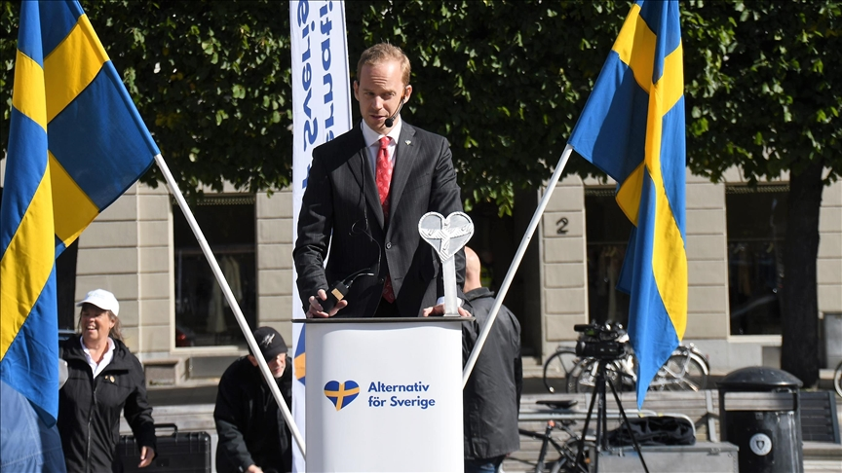

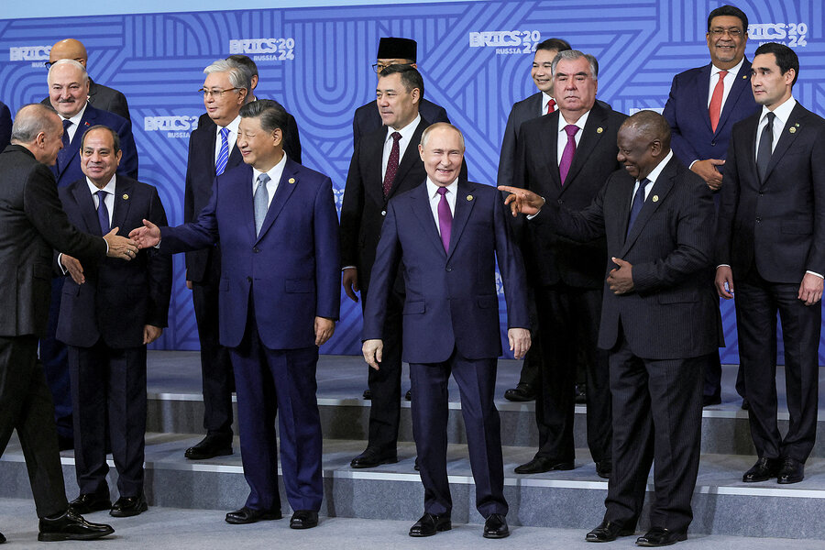

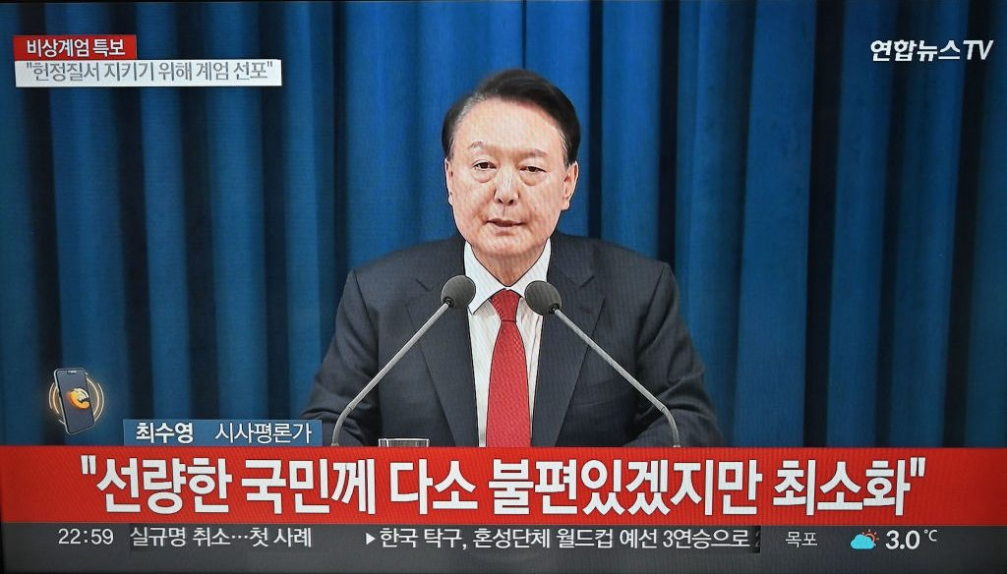
Democratic Backsliding
, or Global Democracy Crisis?
Notes:
“trade and economic endeavour should be conducted with a view to raising standards of living, ensuring full employment and a large and steadily growing volume of real income and effective demand, developing the full use of the resources of the world and expanding the production and exchange of goods.” Institutional development frequently depends on prior outcomes ("path dependence") and evolutionary forces. As institutions evolve, rational design choices can arise in two ways. First, participants may modify institutions in stages, by making purposeful decisions as new circumstances arise, by imitating features from other institutions that work well in similar settings, or by designing explicit institutions to strengthen tacit cooperation. Second, institutions may evolve as states (and other international actors) select among them over time. States favor some institutions because they are better suited to new conditions or new problems and abandon or downplay those that are not. For example, the obvious place to handle intellectual property rights would seem to be the World Intellectual Property Organization, but the countries that generate most patents chose to move the issue to the WTO because it offered better enforcement mechanisms. Thus the institutionalization of the issue evolved significantly, not because an older institution was modified, but because another one offered a better institutional design.

Slide 3
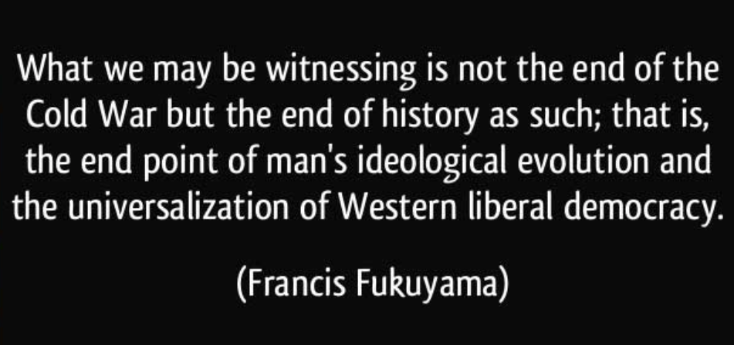
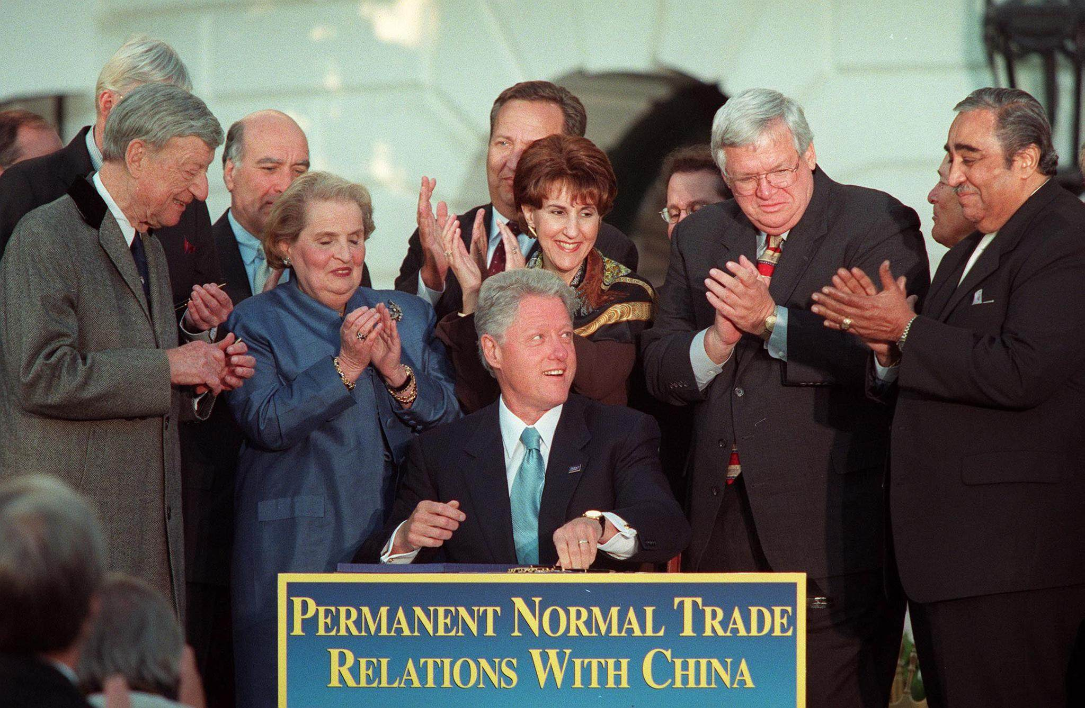
vs. 1990s Optimism
"...So if you believe in a future of greater openness and freedom for the people of China, you ought to be for this agreement."
Notes:
“trade and economic endeavour should be conducted with a view to raising standards of living, ensuring full employment and a large and steadily growing volume of real income and effective demand, developing the full use of the resources of the world and expanding the production and exchange of goods.” Institutional development frequently depends on prior outcomes ("path dependence") and evolutionary forces. As institutions evolve, rational design choices can arise in two ways. First, participants may modify institutions in stages, by making purposeful decisions as new circumstances arise, by imitating features from other institutions that work well in similar settings, or by designing explicit institutions to strengthen tacit cooperation. Second, institutions may evolve as states (and other international actors) select among them over time. States favor some institutions because they are better suited to new conditions or new problems and abandon or downplay those that are not. For example, the obvious place to handle intellectual property rights would seem to be the World Intellectual Property Organization, but the countries that generate most patents chose to move the issue to the WTO because it offered better enforcement mechanisms. Thus the institutionalization of the issue evolved significantly, not because an older institution was modified, but because another one offered a better institutional design.

Slide 4
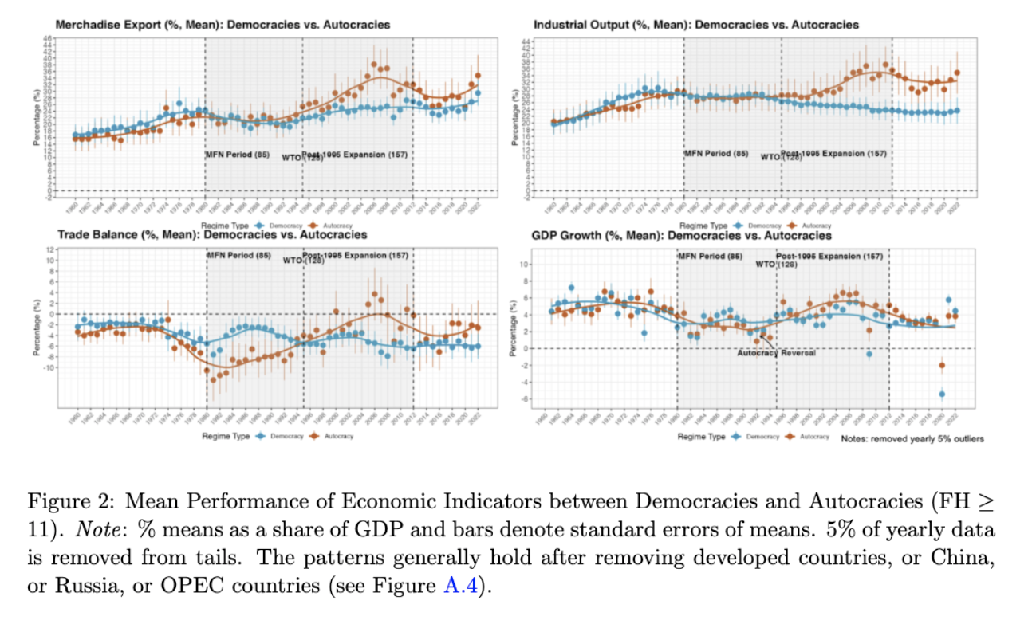
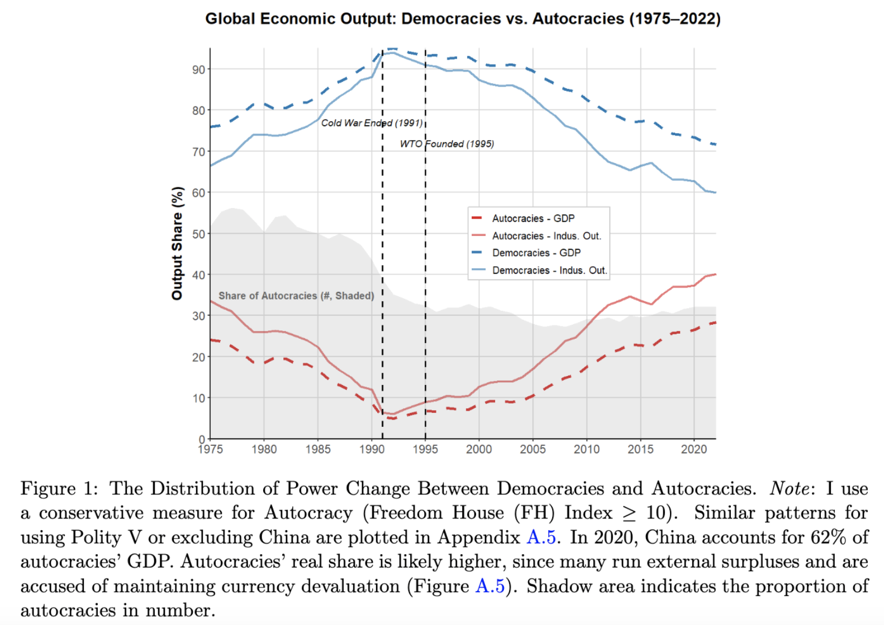
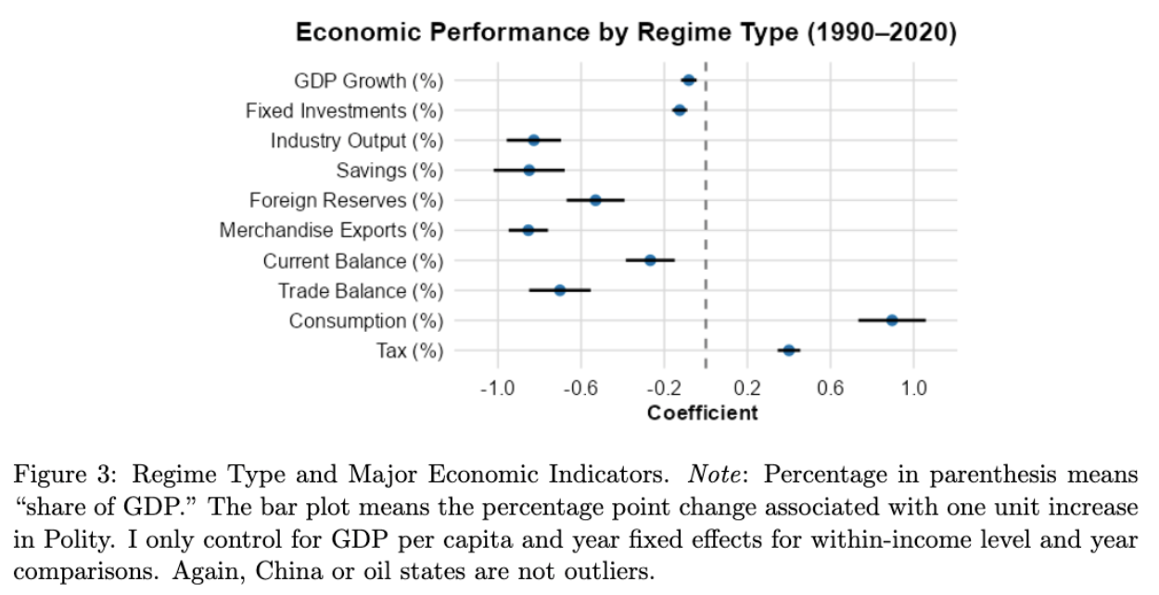
Puzzle: Autocratic Rise
Not only democratic backsliding

Slide 5
Implications
Poor performance de-consolidates democracy Przeworski et al. 2000; Svolik 2008; Rodrik 2016
Good performance strengthens autocracy Baturo and Tolstrup 2024; Oser and Hooghe 2018; Wright, Frantz and Geddes 2013
A world less cooperative and more conflictual Bueno de Mesquita and Siverson 1995; Lake 1996
➔ happening now

Slide 6

Puzzle vs. Existing Literature
Regime type & growth: mixed
(Przeworski et al. 2000; Barro 1996)
Regime type & exports: democracy is better (Eichengreen and Leblang 2007; Levchenko 2007; Yu 2010)
Institutionalism: inclusive is better
(Acemoglu et al. 2001; Acemoglu et al. 2012; North 1990)
Mostly use pre-2000 data
Primarily on internal mechanisms (black-box)
Ignore global transformation post-1990

Slide 7
Main Argument
Autocratic Institutions:
Although weak in generating internal demand due to non-inclusive political institutions
Strong in competing for external demand relying on (enabled by) a globalized economy
Only “Engaged Reformers” – reformed and engaged by the global trade regimes (discussed later).

Slide 8
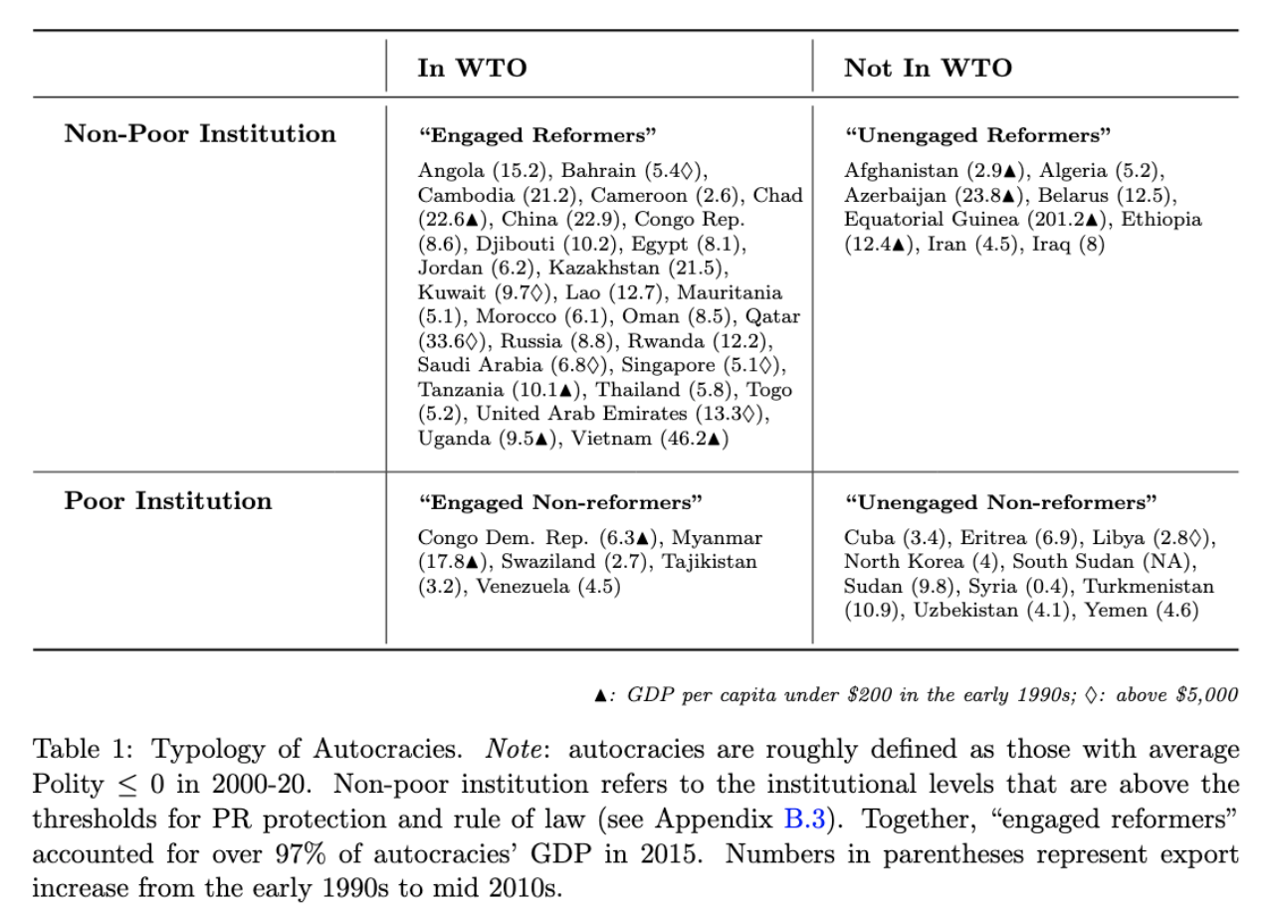
“Engaged Reformers”: Face Validation

Slide 9
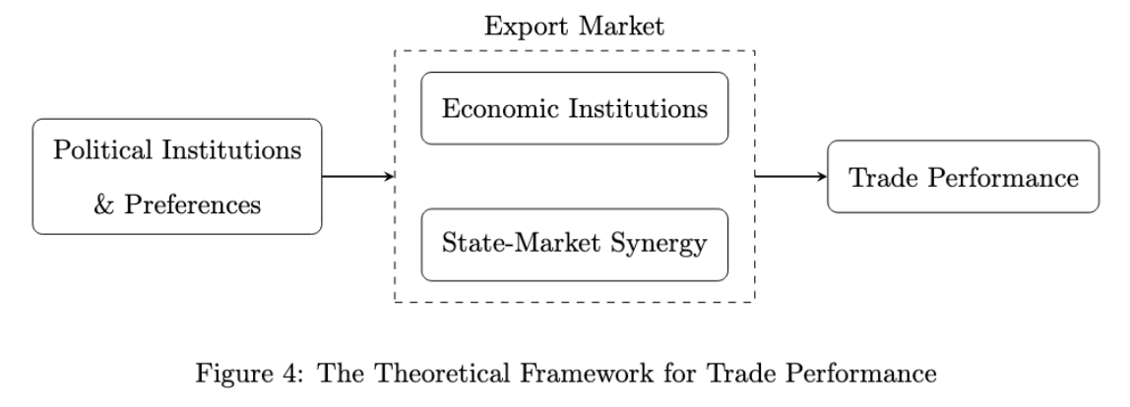
Determinants of Performance
Growth/Development Theories
Exogenous growth (Solow 1957); Endogenous growth (Romer 1986)
Institutional theory (North 1990; Acemoglu et al. 2005)
Developmental state model / export-oriented (Evans 1995; Haggard 1990; Rodrik 2004) (echo structural transformation (Lewis 1954) need intuitional pre-condition)
overlook external factor
trade
Three determinants:
Economic Institution
Trade / expanded market
State policy
Notes:
This is not simply state capacity or reckless interventions as often critiqued, but emphasizing government autonomy to drive industrialization (echoing structural transformation theory (Lewis 1954)) and state-market synergy in collaboration with the private sector such as pushing for reforms and solv- ing market failure.

Slide 10
Globalized Economy & Autocratic Advantage

Slide 11
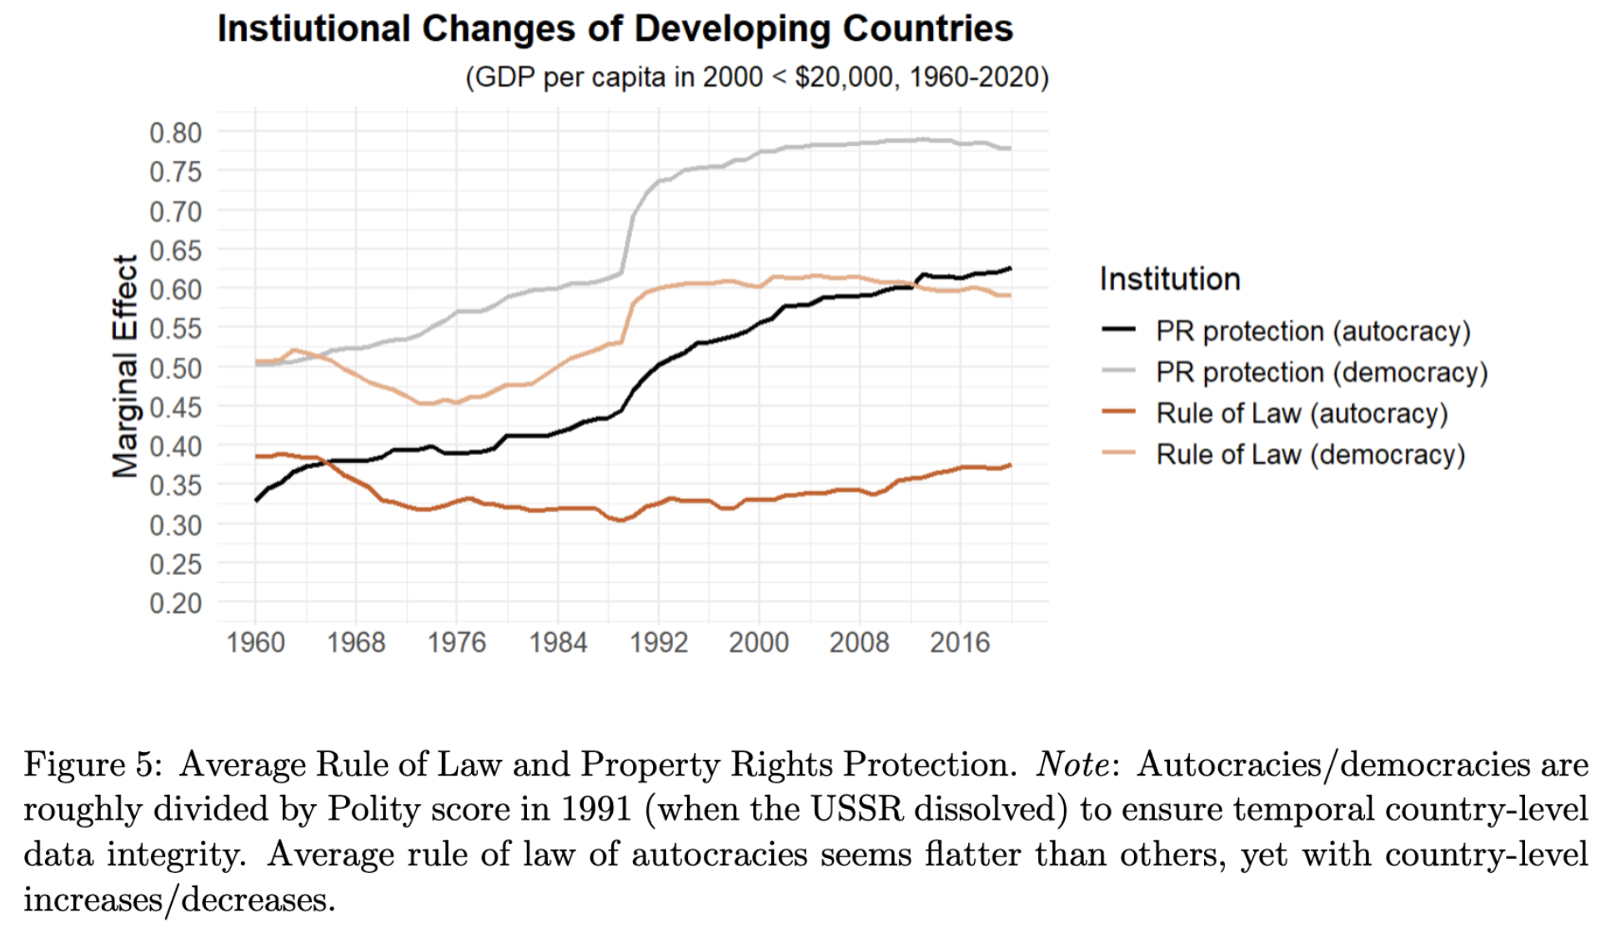
What Happened? Institutional Reform
Both autocracies and democracies
Marketization & institutional reform
PR protection and RoL most important inst. (Acemoglu et al. 2005)
Structure market player’s incentives
E.g. Turkmenistan vs. Azerbaijan

Slide 12
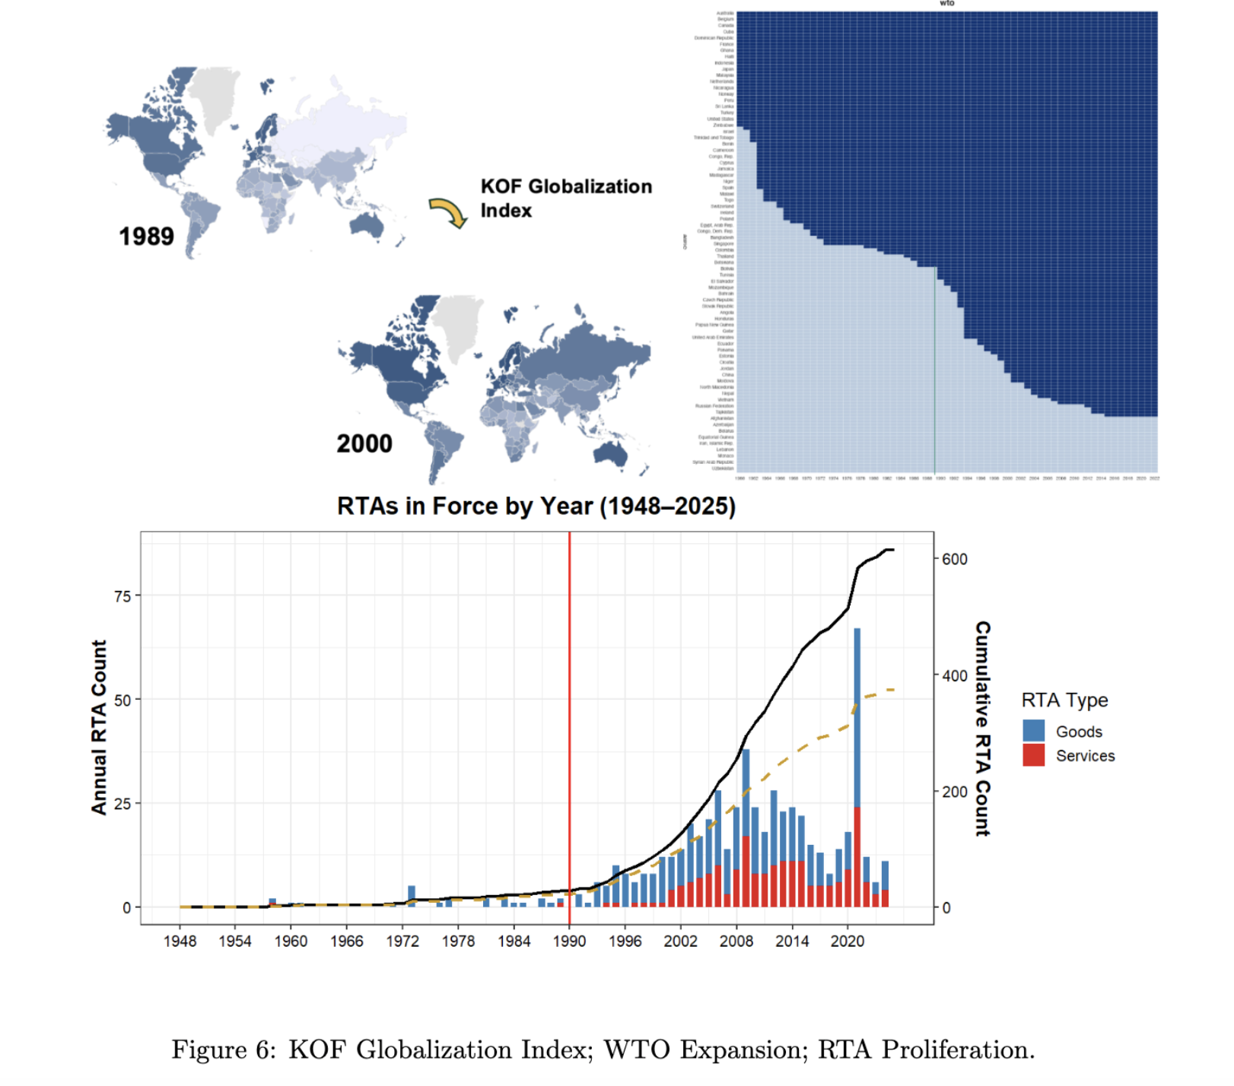
What Happened? Trade Integration
WTO – major role in facilitating trade liberalization -- “the most heralded commercial agreement in history” (Bagwell and Staiger 2002; Goldstein et al. 2007)
Other: MFN/PTA, RTA
IOs enhance credible commitments
e,g., “by 2000, most post-communist countries reoriented trade to Western markets” (Aslund 2012)

Slide 13
“Engaged Reformers”: Face Validation
Notes:
In essence, “engaged reformers” adopted liberal economic institutions and were incorporated into the most significant liberal trade regime, while “embedding” authoritarian institutions into economic liberalization.

Slide 14
Hypotheses
H1.1 Autocracy should predict larger effect of WTO accession on exports in the post-1990 globalized period than democracy on average.
H1.2 The WTO effect difference moderated by regime type in H1.1 should diminish when domestic institutional level is either too low or too high.
H2.1 Autocracy should predict larger effect of domestic reform on exports in the post-1990 globalized period than democracy on average.
H2.2 The reform effect difference moderated by regime type in H2.1 should diminish when countries are excluded from global trade integration.
H3.1 Within the WTO, autocracy should predict more exports, but this effect should be strongest when institutional level is moderate and diminish when domestic institutional level is too low or too high.
H3.2 For all countries with moderate institutional levels, autocracy should predict more ex- ports, but this effect should be stronger when states are in the WTO.
H4 Autocracy should predict higher external balances (current account and trade) than democ- racy in a globalized economy.

Slide 15
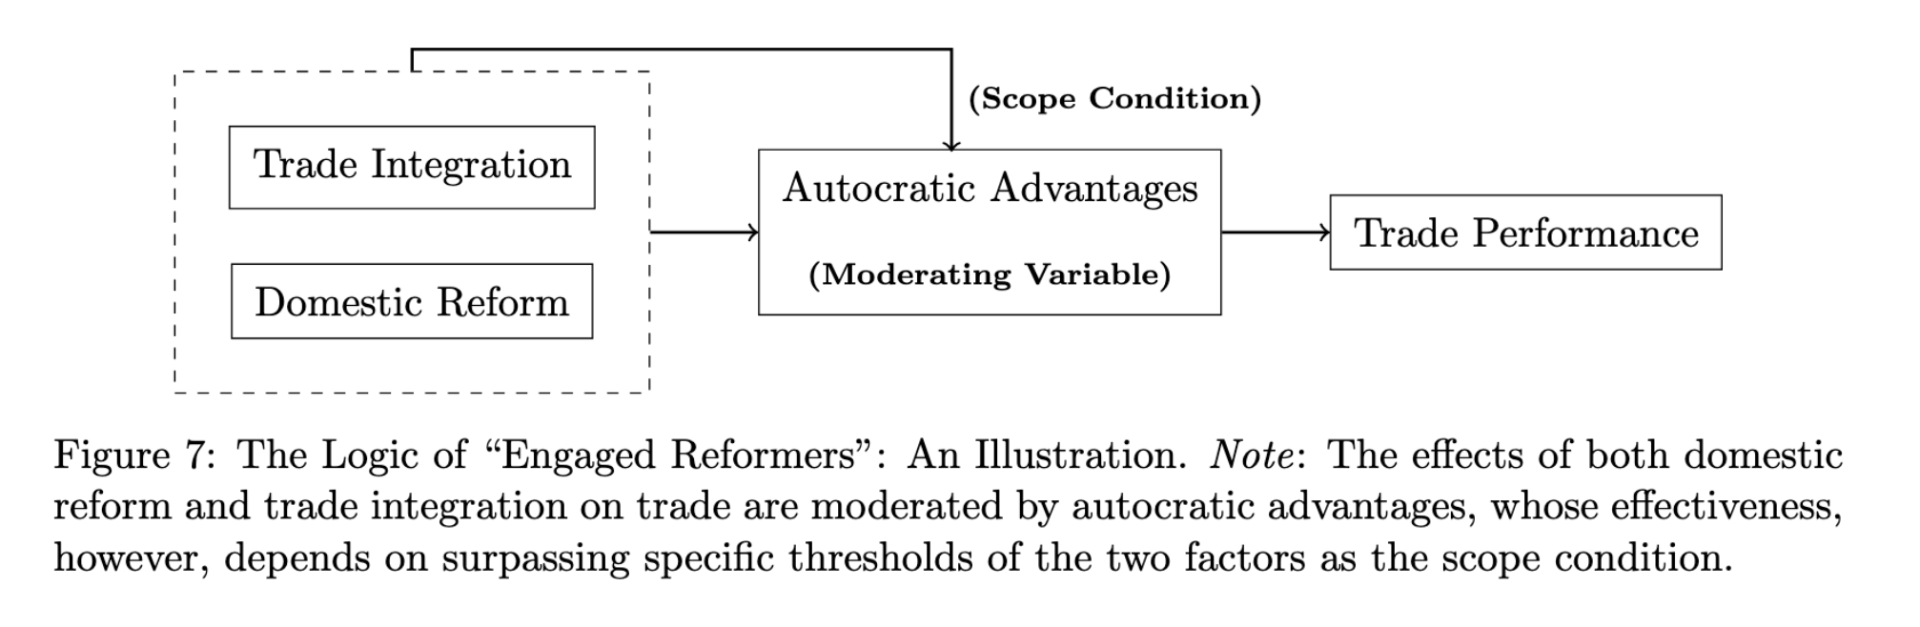
The Logic of “Engaged Reformers”
Notes:
-because of autocratic adv, the same change in both factors may benefit autocracy more for countries with otherwise similar baselines; thanks to “autocratic advantages,” the
more autocratic state can posses more discretionary power to surpress labor and environmental interests, manipulate capital account and exchange rate, tilt resources from welfare to production, or sign favorable deals with foreign firms.
-However, this is not without scope condition.
-e.g., for two otherwise similar autocracy and democracy, if their inst is too low, then autocratic adv in joining the WTO may diminish

Slide 16
Empirics

Slide 17
DV (re/ External Demand)
Exports
Gain in income/productivity/innovation (Bernard et al. 2018; Helpman and Krugman 1985)
r = 0.74 (avg. growth rate, 1992-2015)
External Balance:
Persistence indicates structural/development issues; redistribution of demand (Blanchard and Milesi-Ferretti 2009; Obstfeld and Rogoff 2009; Chinn and Ito 2021)
r = 0.65 (avg. growth rate)
Success stories: East Asia, Core Europe, Gulf states
17 of 20 highest R&D expenditure countries

Slide 18
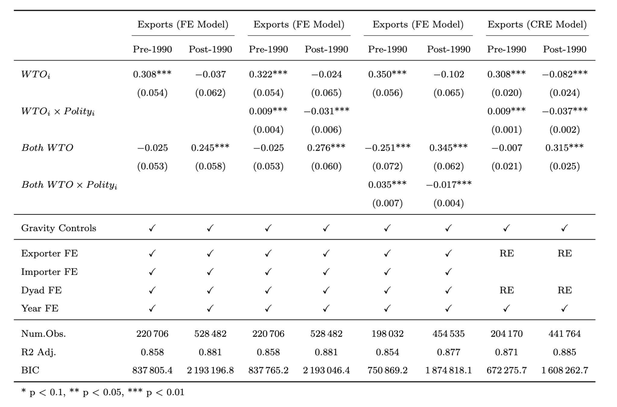
Result 1.1: WTO Accession
Gravity model:
(Anderson & van Wincoop 2003; Carnegie 2014; Goldstein et al. 2007; Ross 2000; Yu 2010 …)
CRE model:
(correlated random-effects)
Polity
-5: 14%
5: -16%
-10: 33%
10: -29%

Slide 19
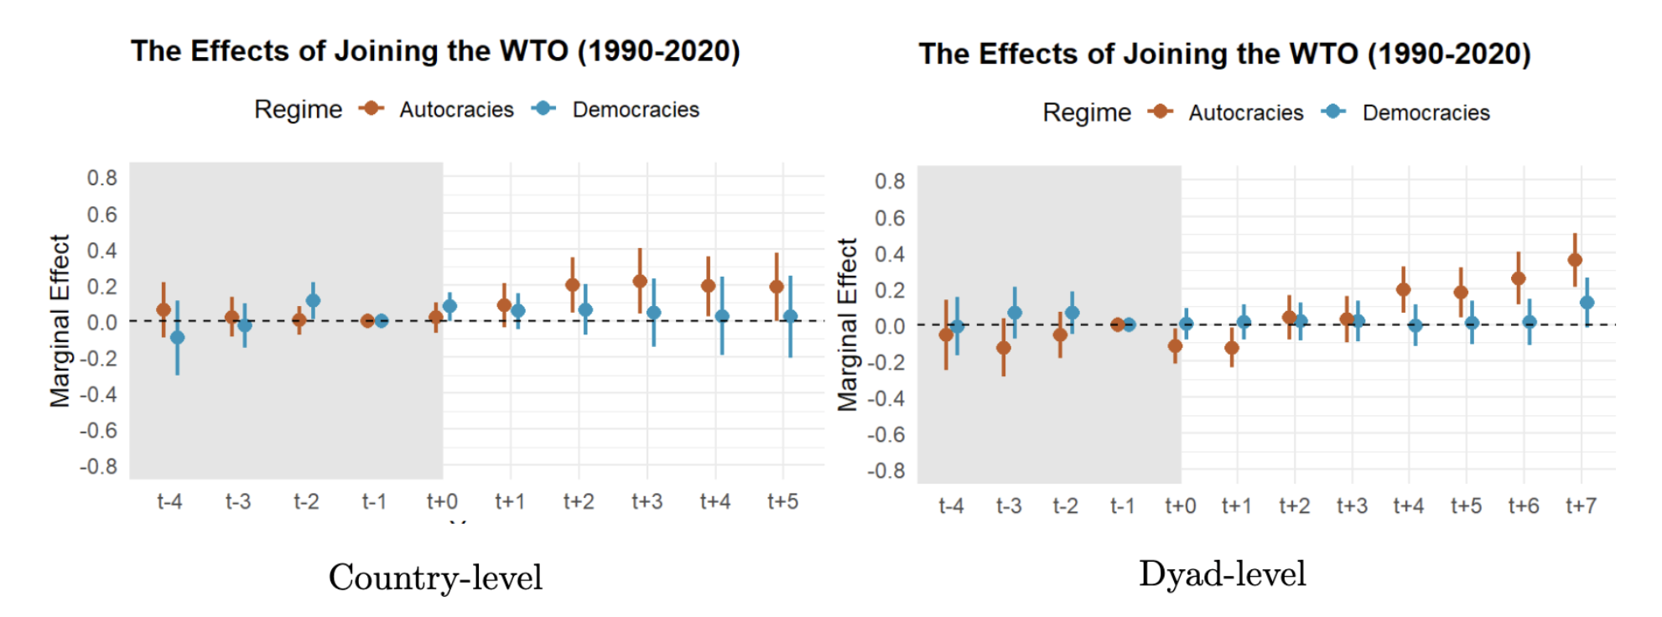
Result 1.1: WTO Accession
Sensitivity Analysis: Population (x250), GDP (x1000), Polity (x12)
DiD w/ matching:

Slide 20
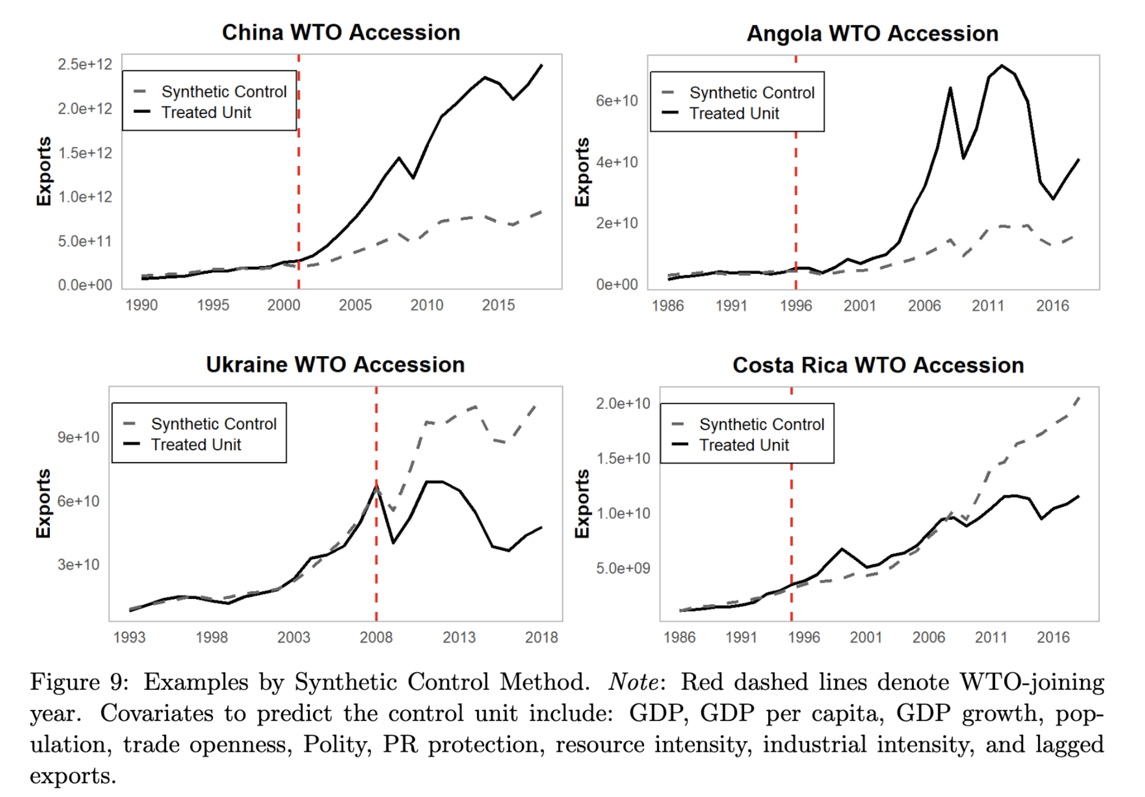
Result 1.1: WTO Accession
Examples, SCM:

Slide 21
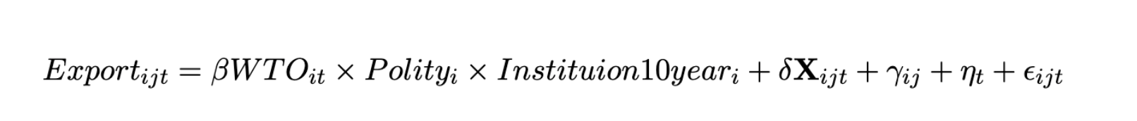
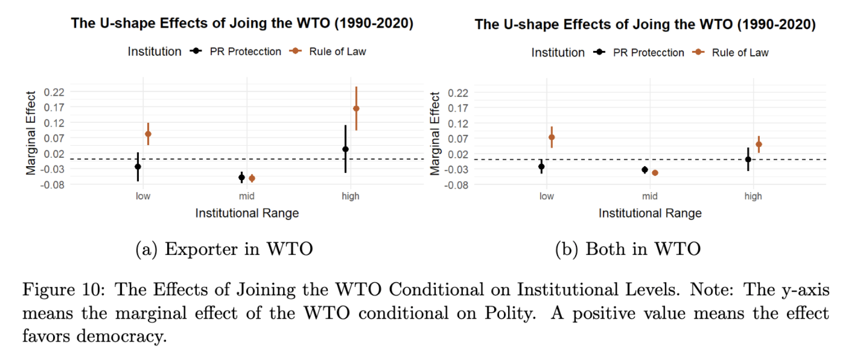
Result 1.2: WTO x Inst. (U-shape)
*inst. range dummy: lowest/highest 20th quantiles in 2000, w/ a ±10 ppt. variation.

Slide 22
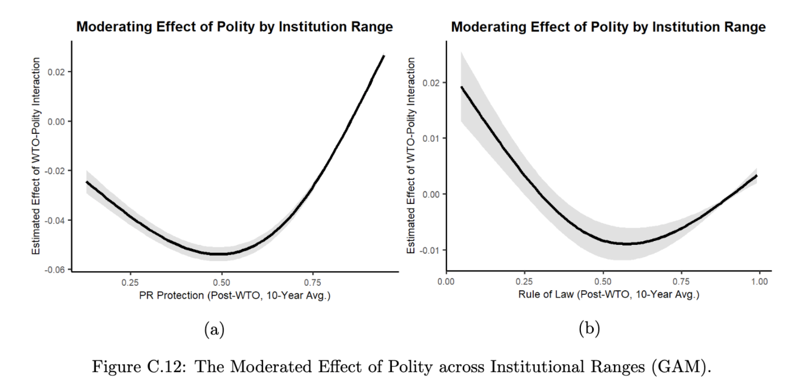
Result 1.2: WTO x Inst.
Semi-parametric estimation (General Additive Model)

Slide 23
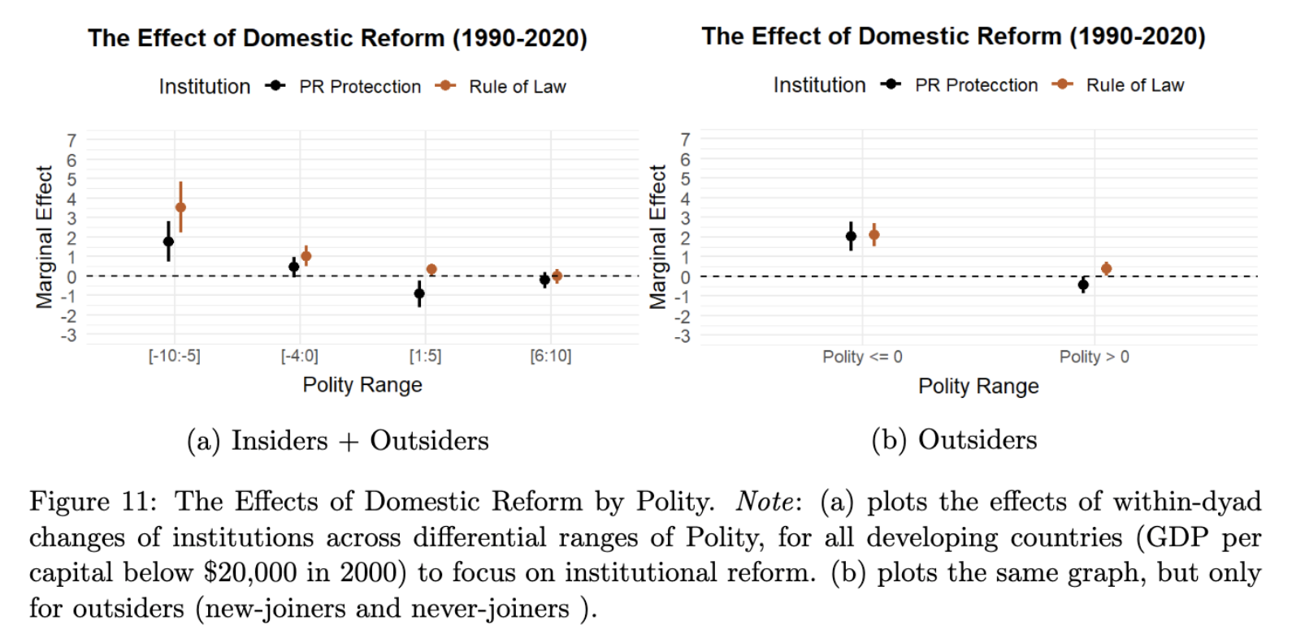
Result 2.1: Inst. Reform

Slide 24
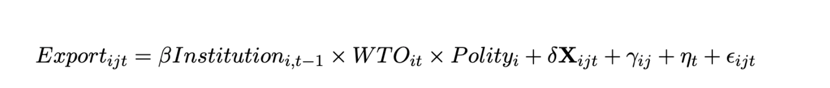
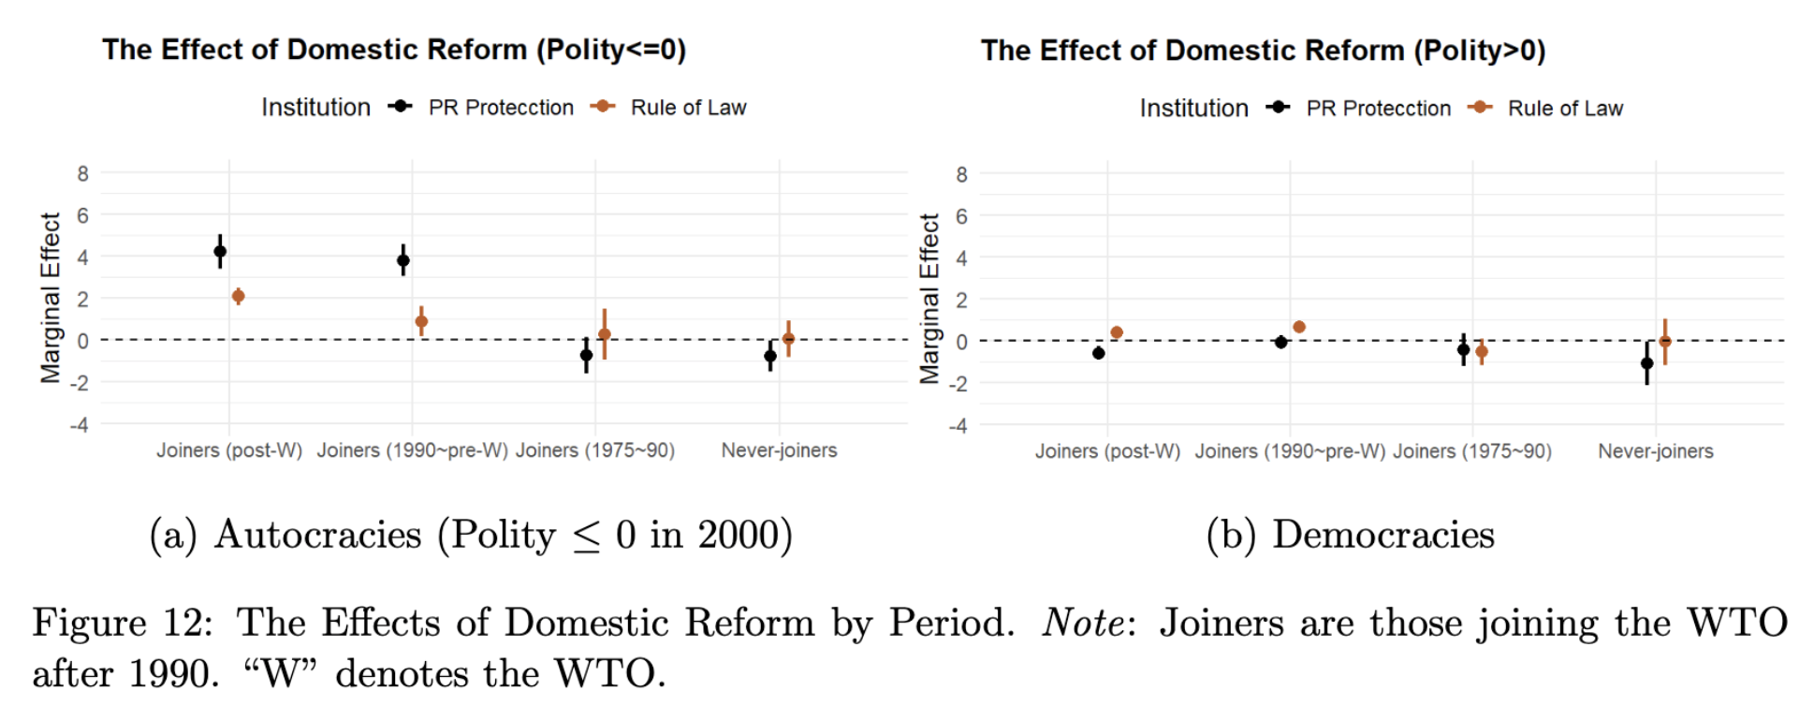
Result 2.2: Inst. x WTO-related Period
Notes:
Although it’s hard to know the counterfactual of reform effect of when joiners are not in WTO, we can still get some effect

Slide 25
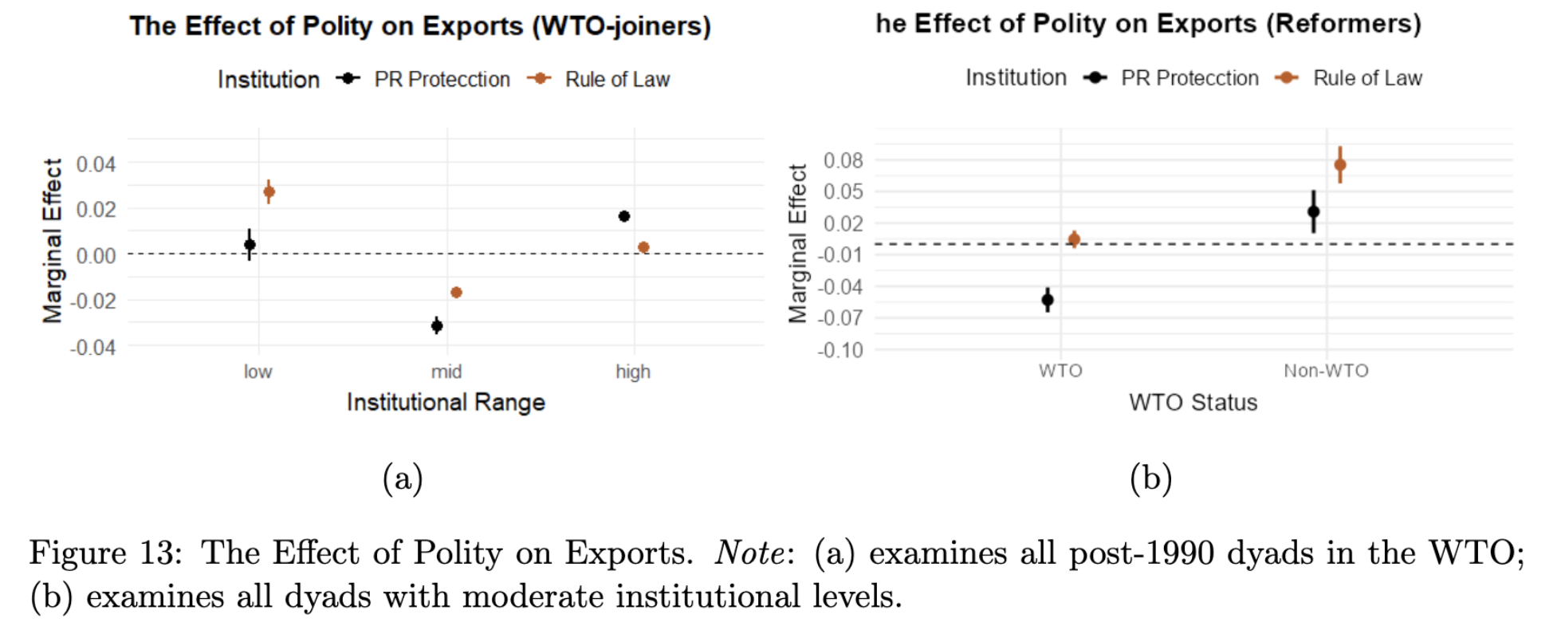
Result 3: Absolute Exports

Slide 26
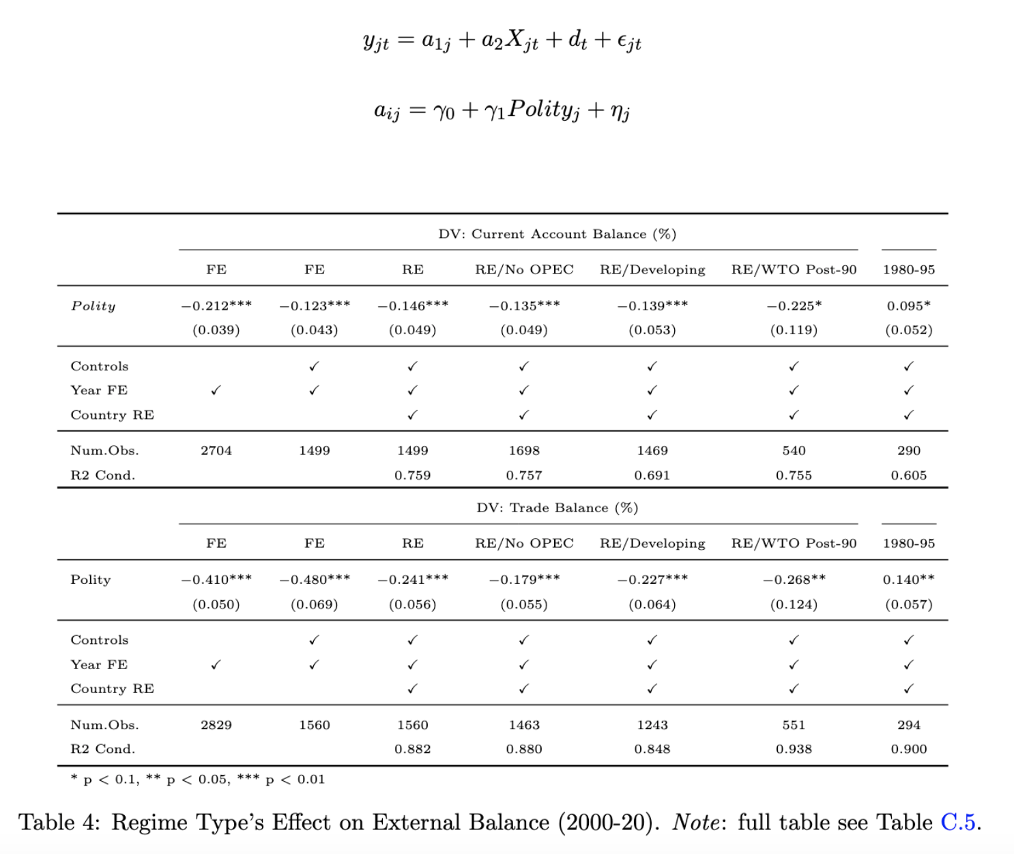
Result 4: External Balance
Hierarchical Model
(Chinn and Ito 2021; Manger and Sattler 2020)

Slide 27
Mechanisms

Slide 28
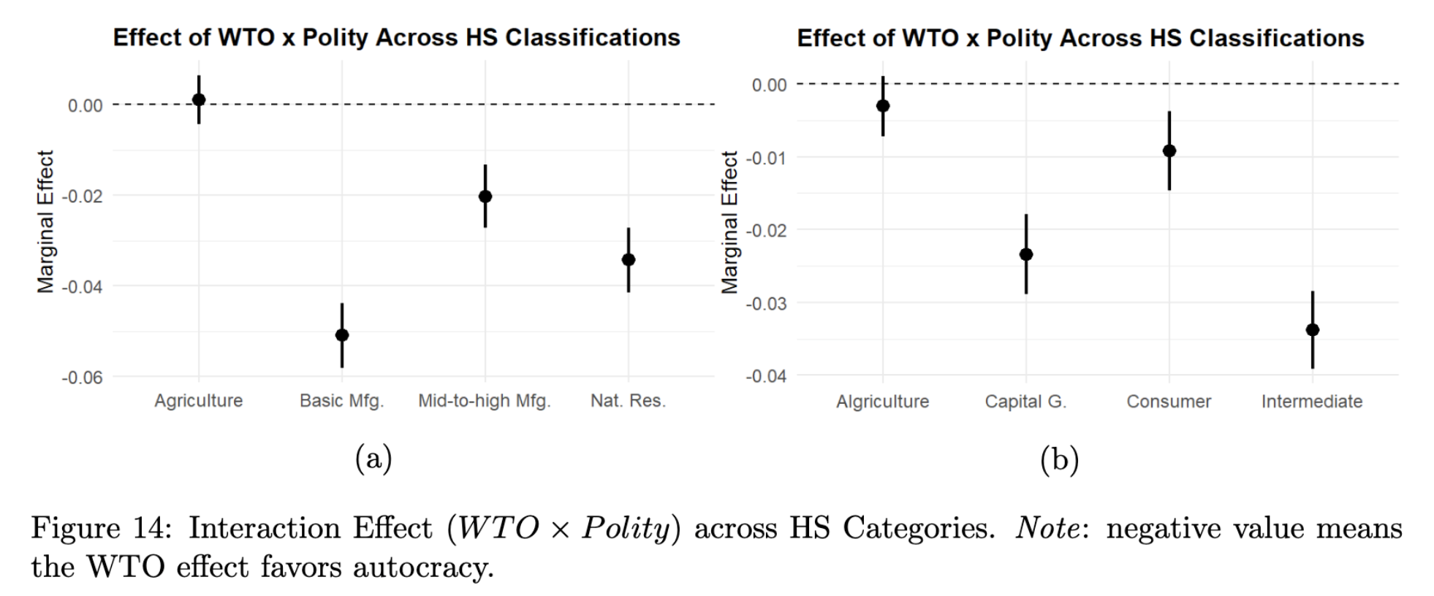
Mechanisms: Sectoral-level Evidence

Slide 29
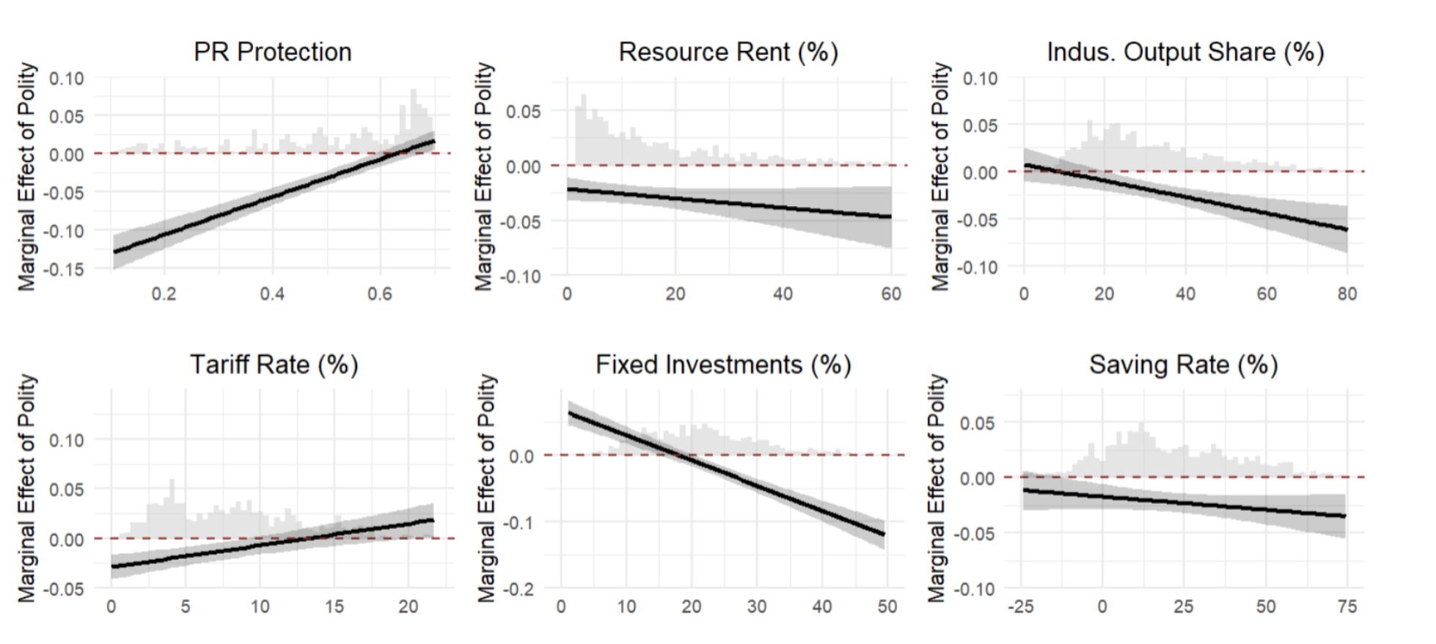
Mechanisms: Mediating Tests

Slide 30
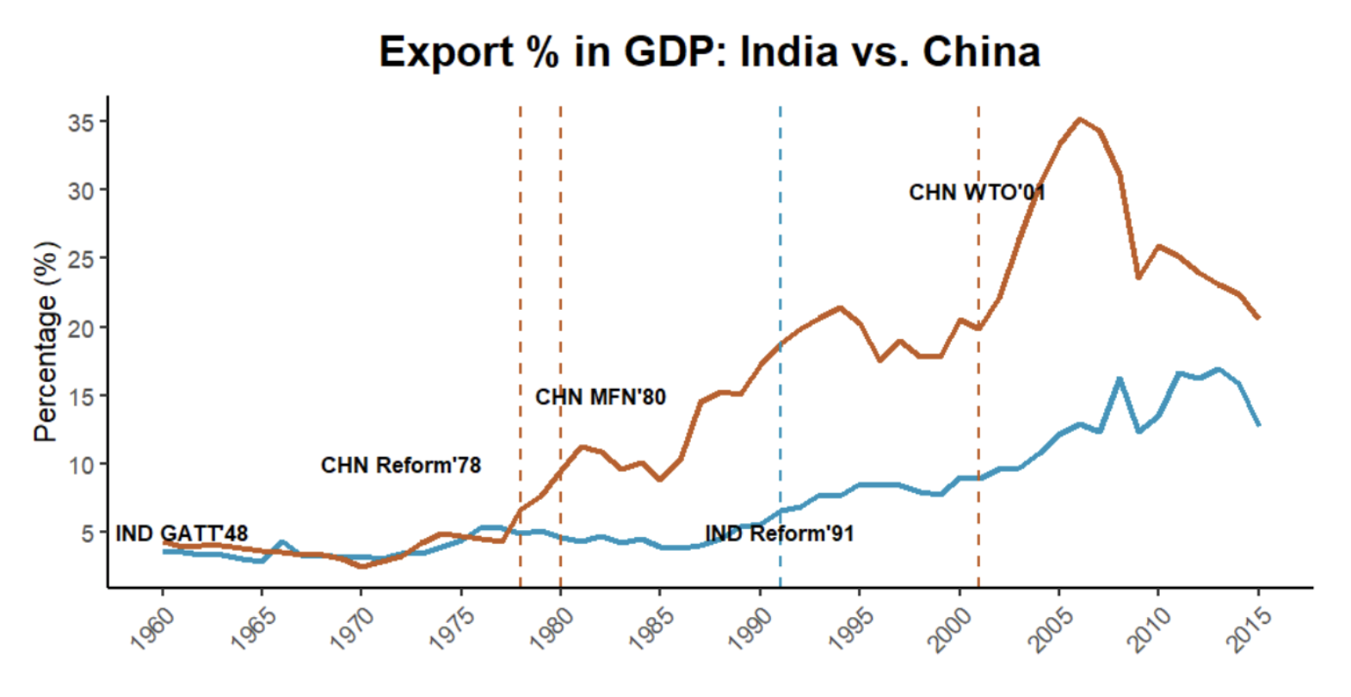
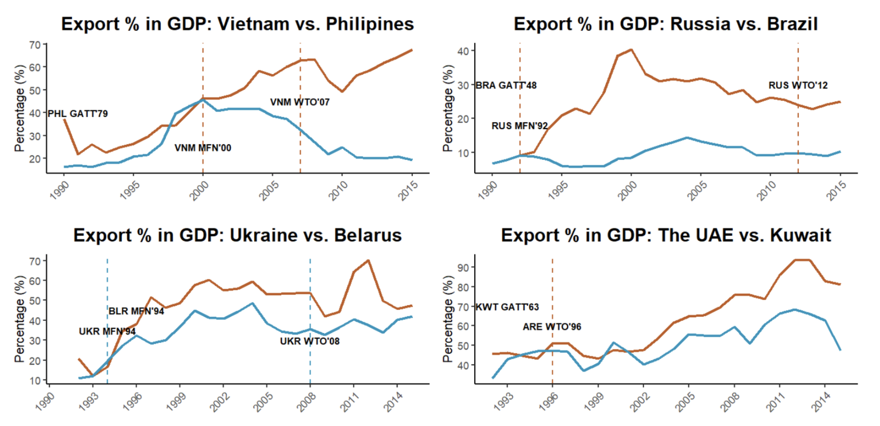
Qualitative Case Comparison
“...China’s political regime allows a gradualist approach which blended state control with market, and long-term planning employing mercantilism (e.g., economic zones and industrial policies) (Lin et al. 2003), as well as the suppression of labor rights…”
“…India’s democratic system, though more inclusive, must navigate coalition politics, public dissent, and legal constraints, resulting in slow decision-making and low mercantilist policies (Groth 2006)…”
See paper for more…

Slide 31
New Setting: How Does Globalized Economy Differ?
Changing development logic vs. enclosed economy
Local factors globally comparable and liquidatable
Earlier trade theory: comparative advantage, specialization (H-O/R-V model)
Newer trade theory: scale, firm selection, GVC/FDI (Krugman 1979; Grossman and Helpman 1991; Melitz 2003; Antras 2015) exports drive income/productivity/innovation (Atkeson & Burstein 2010; Burstein & Melitz 2013)
⇒ Shift focus to external: demand/technology/capital
Exploiting free trade
One-time gain, long-term uncertain (Garret 2000); 10% explained by comp. adv. (Osgood 2017)
Assumptions may not hold: balanced trade/exo. imbalance, no friction, effective f/x ⇒ strategic trade theory, export-oriented model, developmental state model …
Interventions can create “artificial cost advantage” (see modes in Eaton & Kortum 2002; Arkolakis et al. 2018; Melitz 2003; Costinot et al. 2013; Epifani & Gancia 2017)
⇒ Create room for manipulative policies
Notes:
the global trade system, combined with floating exchange rates and freer capital flows

Slide 32
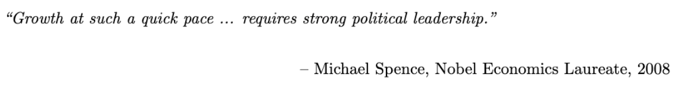
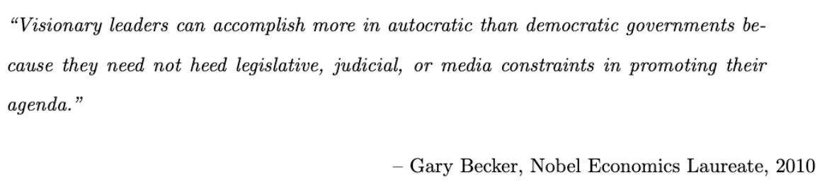
Autocratic Advantage? Quotes…

Slide 33
Autocratic Advantages in Globalized Economy?
Since 80/90s, neoliberal reforms often rely on authoritarian measures (Bruff 2014)
Disadvantage ⇒ advantage: inst. & non-inst. (reformed autocracies)
Centralized power: no extensive deliberation, respond swiftly, resist shocks, consistent planning, state support (Clegg et al. 2018; Haggard 1990; Kim 2018; Wade 1990; Wu 2016)
Weak institutional constraints: lack opposition/lobby, large win-set, resist consumption, divert resources to exp/indus, attract MNCs, dishonor commitments, manipulate policies (Allen & Ge working; Brune et al. 2001; Steinberg and Malhotra 2014; Lipscy 2018; Putnam 1995)
Lack of accountability: push for market-favoring policies, resist redistribution, suppress labor/env/corporatist, impose austerity/saving, favor MNCs (Quinn and Woolley 2001; Sah 1991; Zakaria 1997; Rodrik 1999; Manger and Sattler 2015; Feierherd 2024; Krueger 1974)
Mercantilist mentality: weak liberal econ norms; narrow interest groups; econ for legitimacy➔ more mercantilism (Dailami 2000; Eichengreen and Leblang 2008; BdeM et al. 2005; Milner and Kubota 2005)
Resource endowment: boosts revenue and buying power. e.g., investing bureaus Qatar, UAE
Notes:
-These measures, partly because they work, were used to manage resistance, enforce compliance, and stabilize systems that prioritize market logic
-some regime characteristics that may otherwise be disadvantages in a relatively closed economy can indeed become advantageous, since the goal is about competing for external demand
-In contrast, many Latin American democracies even have stricter labor regulations than OECD countries (Feierherd 2024)

Slide 34
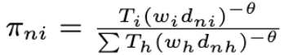
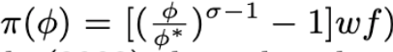
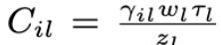
e.g. Trade Models
Eaton & Kortum 2002:
Melitz 2003:
Arkolakis et al. 2018:
Notes:
-These measures, partly because they work, were used to manage resistance, enforce compliance, and stabilize systems that prioritize market logic
-some regime characteristics that may otherwise be disadvantages in a relatively closed economy can indeed become advantageous, since the goal is about competing for external demand
-In contrast, many Latin American democracies even have stricter labor regulations than OECD countries (Feierherd 2024)

Slide 35
Examples …
Autocracy:
Asian dragons/tigers: Korea, Taiwan, Malaysia, Singapore, China, Hong Kong, Vietnam…
Gulf states: UAE, Saudi Arabia, Qatar, Bahrain, Kuwait…
Other: Pinochet Chile, Modi’s India vs. INC, Ben Ali’s Tunisia vs. democratization…
Democracy:
Major developing: Argentina, Brazil, Bolivia, Chile, Colombia, India, Indonesia, Kenya, Mexico, Nigeria, Pakistan, Peru, Philippines, South Africa, and Ukraine…
Developed: deindustrialization, stagflation, democratic backsliding (in the post-CW age)…
*Autocracies account for 25% of total countries, but 60%+ top 50 fastest growing countries (1992-2015)

Slide 36
Possible Questions
Selection bias?
Catch-up story?
State capacity?
Democracy-autocracy trade before 1990?
Back-and-forth in GVC?
Spillover and commodity boom?
MFN status?
FDI?

Slide 37
Conclusion
Takeaways:
Autocratic success is unlikely without relying on external demand and a globalized economy (flip side: democratic backsliding)
A theory for global democracy crisis ⇒ external factor (complement Acemoglu et al., Ang…)
If “Trump is the outcome” and there’re structural causes behind trend – may get worse if causes unaddressed
Free trade/globalization is not wrong; policymakers ignored conditions and assumptions
Thank you!

